Slide 1
How Insightful!
Grok Your ASP.NET Core Web Apps with Application Insights Azure Monitor

Slide 2

Hi! I’m Cam. I work for Microsoft.

Slide 3
What we’ll cover
What Azure Monitor is and why you need it
Setting up Application Insights
Viewing Application Insights telemetry
Using telemetry in our ASP.NET Core app to solve:
A performance bottleneck
An unhandled exception

Slide 4

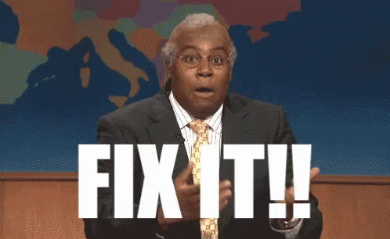
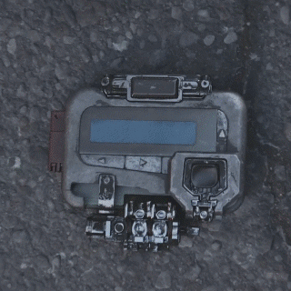
Production debugging under pressure

Slide 5










What is App Insights?

Slide 6
What Kind of Telemetry?
Request/Response Information
Dependencies (SQL, 3rd Party Apis)
Page Views/Load
User Information
Exceptions
Everything Else

Slide 7

Flow of Application Insights

Slide 8
Anatomy of

Slide 9
Thank you!

